Slide 1

IOT VIRTUAL DOCTOR ROBOT
Department of Electronics and Communication Engineering
Jaypee Institute of Information Technology, Noida, U.P., India
Presented by:
Aakash Mehta (20102004)
Rishika Bahl (20102169)
Under the supervision of
Mr. Mandeep Narula

Slide 2
CONTENTS
INTRODUCTION
FLOWCHART
WORKING
APPLICATIONS
COMPONENTS AND FEATURES
ADVANTAGES
DISADVANTAGES
SCOPE OF OUR PROJECT
REFERENCES

Slide 3
INTRODUCTION
Doctors are usually needed to work at every hospital and emergency center every now and then because of which is not feasible for every doctor to be available at every place at desired time.
The problem with video calling is that video calls need to be done from a PC or laptop on a desk. This limits the doctors capacity to view patient or around operation theatre at will or even move through hospital rooms as needed.

Slide 4
This system makes use of a robotic vehicle with 4 wheel drive for easy navigation.
The robot also includes a controller box for circuitry and a mounting to hold a mobile phone or tablet. The mobile or tablet is used to hold live video calls.
The doctor can use an IOT based panel to control the robot. The control commands sent sent online are received by the robot controller.

Slide 5
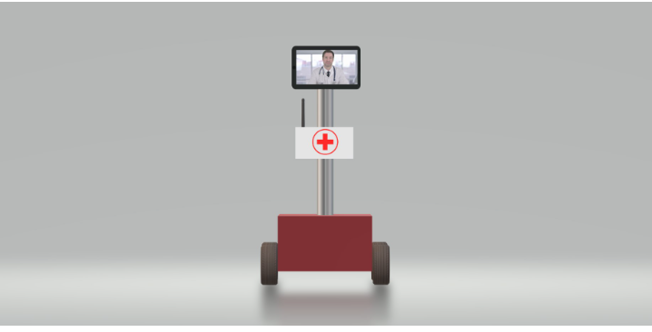
DIAGRAM
FRONT VIEW

Slide 6
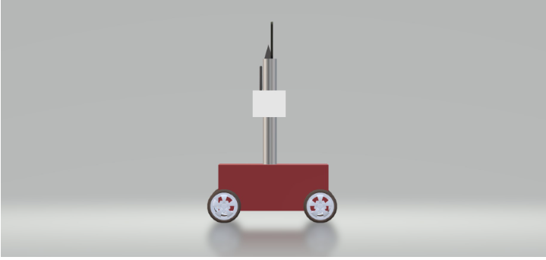
SIDE VIEW

Slide 7
WORKING OF OUR PROJECT
The system makes use of a robotic vehicle with 4 wheel drive for easy navigation.
The robot also includes a controller box for circuitry and a mounting to hold a mobile phone or tablet. The mobile or tablet is used to hold live video calls.
The doctor can use an IOT based panel to control the robot.
The control commands sent online are received by the robot controller.
The robot controller operates over wi-fi internet.
The received commands are received in real time and the robot motors are operated to achieve the desired movement commands. Also the root has other functions including battery status alert to remind of battery charging on time

Slide 8
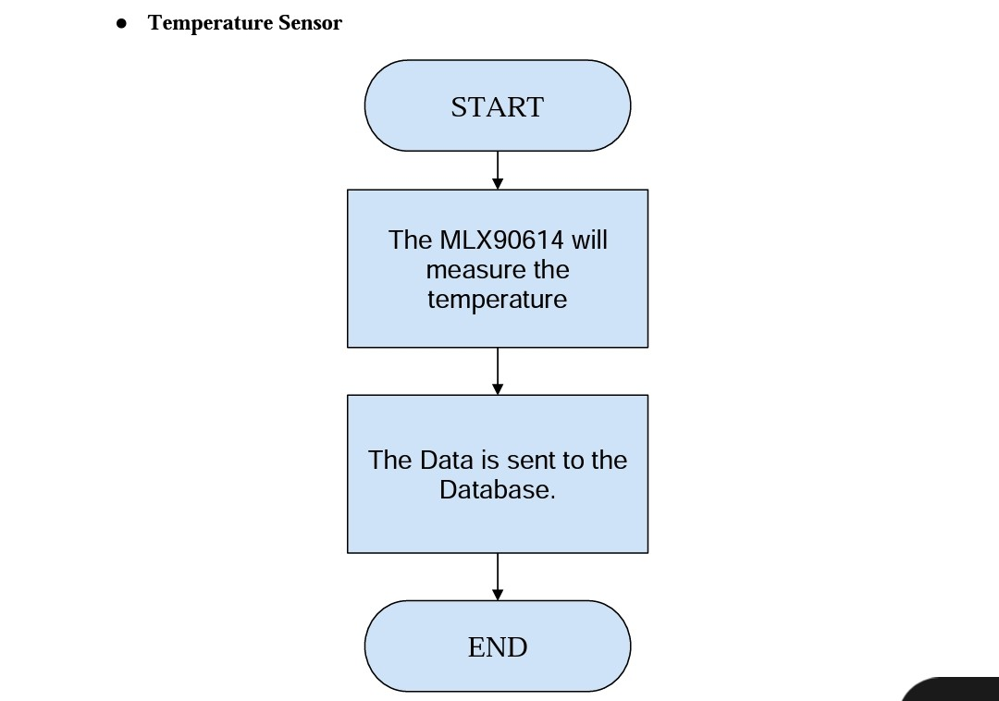
FLOWCHART

Slide 9
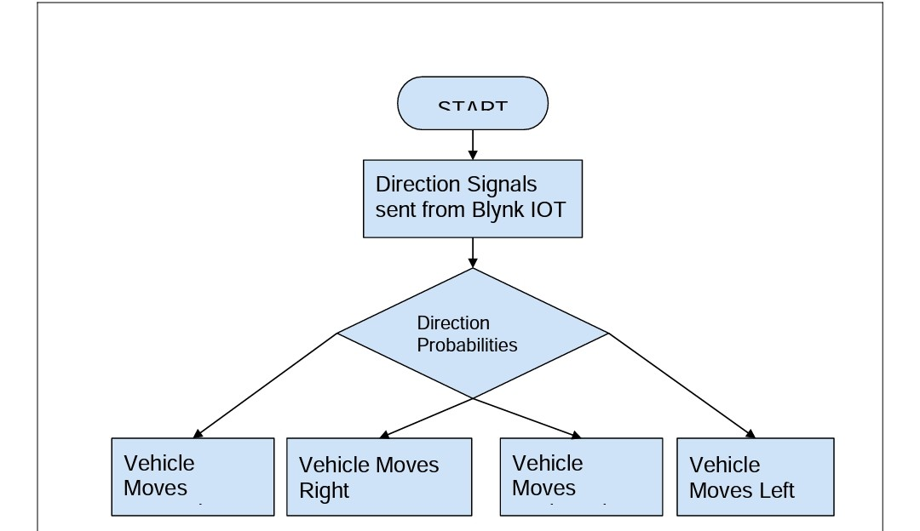

Slide 10
APPLICATIONS
Our model can be implemented in various in hospital center's and clinics as they will make the process more simpler and efficient whilst being cost effective.
This model can also be used at emergency center's to help with crowd load in busy hospitals and because this process requires very little interaction with other sick patients and is hence more efficient in such places to prevent spread of other diseases.

Slide 11
FEATURES
Many features of our project are-
The key feature of this project is that it makes the checkup process contactless and is accurate.
Our project has very low running cost as it does not require additional workforce to be hired. Hence, it can also be used in a wide scale in any health care facility
Remote Monitoring : The robot can take be monitored and controlled via remote control over Wi-fi.
Language/Software we are going to use : Arduino Programming (C++)

Slide 12
COMPONENTS
Nodemcu board
L298N motor driver
Gear motor
Robot wheels
Jumper wires
Foamboard / cardboard
Battery

Slide 13
ADVANTAGES
Doctors ability to be at anyplace anytime as it is online and wireless means through which they are diagnosing the patient.
Doctors can move around in operation theatres with ease without affecting the sterile field in the theatre.
Doctors can see the medical reports and test results via video calls remotely from another city as well
They can move around in between rooms.

Slide 14
Due to this device people living in remote areas and rural areas can be diagnosed with the best specialists of the country
The patients living far away don’t need to travel while being sick in order to be diagnosed.

Slide 15
DISADVANTAGES:
Requires Battery Charging which may not be possible in remote areas due to electricity issues and is not useful if discharged completely.
Need to attach a Tab or Mobile Phone in order to establish connections and help with diagnosis.

Slide 16
SCOPE OF OUR PROJECT
This device can really be a technological boon and advancement in the market as it is very precise while diagnosing.
These prototypes of these Robots can be implemented in health centers wherever possible making the checkups of the individuals hassle free.

Slide 17
REFERENCES
https://www.javatpoint.com/Arduino-ide#:~:text=The%20Arduino%20IDE%20is%20an,stands%20for%20Integrated%20Development%20Environment
https://en.wikipedia.org/wiki/
https://www.amazon.in/
https://www.youtube.com/watch?v=huWn4Sx99hQ&feature=youtu.be
https://nevonprojects.com/iot-virtual-doctor-robot/

